Slide 1
N.R.M SUPPORT
“Where all tech needs are met”

Slide 2
Business Perspective
Employees have been incurring expenses while on company time and there are no proper contingencies in place.
The Tech Team was tasked with creating an expense reimbursement web-based application to fix this issue.
The application will be able to provide a tracking system for all reimbursements, this web application will be used by Admins, Finance Managers and Authorized Employees only.

Slide 3
SDLC-Software Development Life Cycle
Stage 1: Project Planning.
Stage 2: Gathering Requirements & Analysis.
Stage 3: Design.
Stage 4: Coding or Implementation.
Stage 5: Testing.
Stage 6: Deployment.
Stage 7: Maintenance.

Slide 4
PLANNING
Preplanning document Consists of the following:
Preliminary Problem Scenario Definition
The new software product will be an Expense Reimbursement System, The Expense Reimbursement System (ERS) will manage the process of reimbursing employees for expenses incurred while on company time. All employees in the company can login and submit requests for reimbursement and view their past tickets and pending requests. Finance managers can log in and view all reimbursement requests and past history for all employees in the company. Finance managers are authorized to approve and deny requests for expense reimbursement.
Preliminary Project Scope
The project is for the purpose of creating a web application that serves as a user interface for employees, admins, and finance managers to submit or handle all reimbursement requests. This system will manage the process of reimbursing employees for expenses incurred while on company time. All registered employees in the company can login and submit requests for reimbursement and view their past tickets and pending requests. Finance managers can log in and view all reimbursement requests and past history for all employees in the company. Finance managers are authorized to approve and deny requests for expense reimbursement.

Slide 5
planning
Functional Objectives:
A new employee or new finance manager can request registration with the system
An admin user can approve or deny first-time registration requests
A registered employee can authenticate with the system by providing valid credentials
An authenticated employee can view and manage their pending reimbursement requests
An authenticated employee can view their reimbursement request history (sortable and filterable)
An authenticated employee can submit a new reimbursement request
An authenticated finance manager can view a list of all pending reimbursement requests
An authenticated finance manager can view a history of requests that they have approved/denied
An authenticated finance manager can approve/deny reimbursement requests
An admin user can deactivate user accounts, making them unable to log into the system
An admin user can reset a registered user's password

Slide 6
Planning
Operational Objectives:
Basic validation is enforced to ensure that invalid/improper data is not persisted
User passwords will be hashed by the system before persisting them to the data source
Users are unable to recall reimbursement requests once they have been processed (only pending allowed)
Sensitive endpoints are protected from unauthenticated and unauthorized requesters using JWTs
Errors and exceptions are handled properly, and their details are obfuscated from the user
The system conforms to RESTful architecture constraints
The system's is tested with at least 80%-line coverage in all service and utility classes
The system's data schema and component design are documented and diagrammed
The system keeps detailed logs on info, error, and fatal events that occur
UI and API builds and deployments are automated using a CI/CD pipeline
API is deployed to AWS EC2 (via Elastic Beanstalk) as a Docker container
UI is deployed to an AWS S3 bucket configured for static web hosting

Slide 7
GATHERING REQUIREMENTS AND ANALYSIS

Slide 8
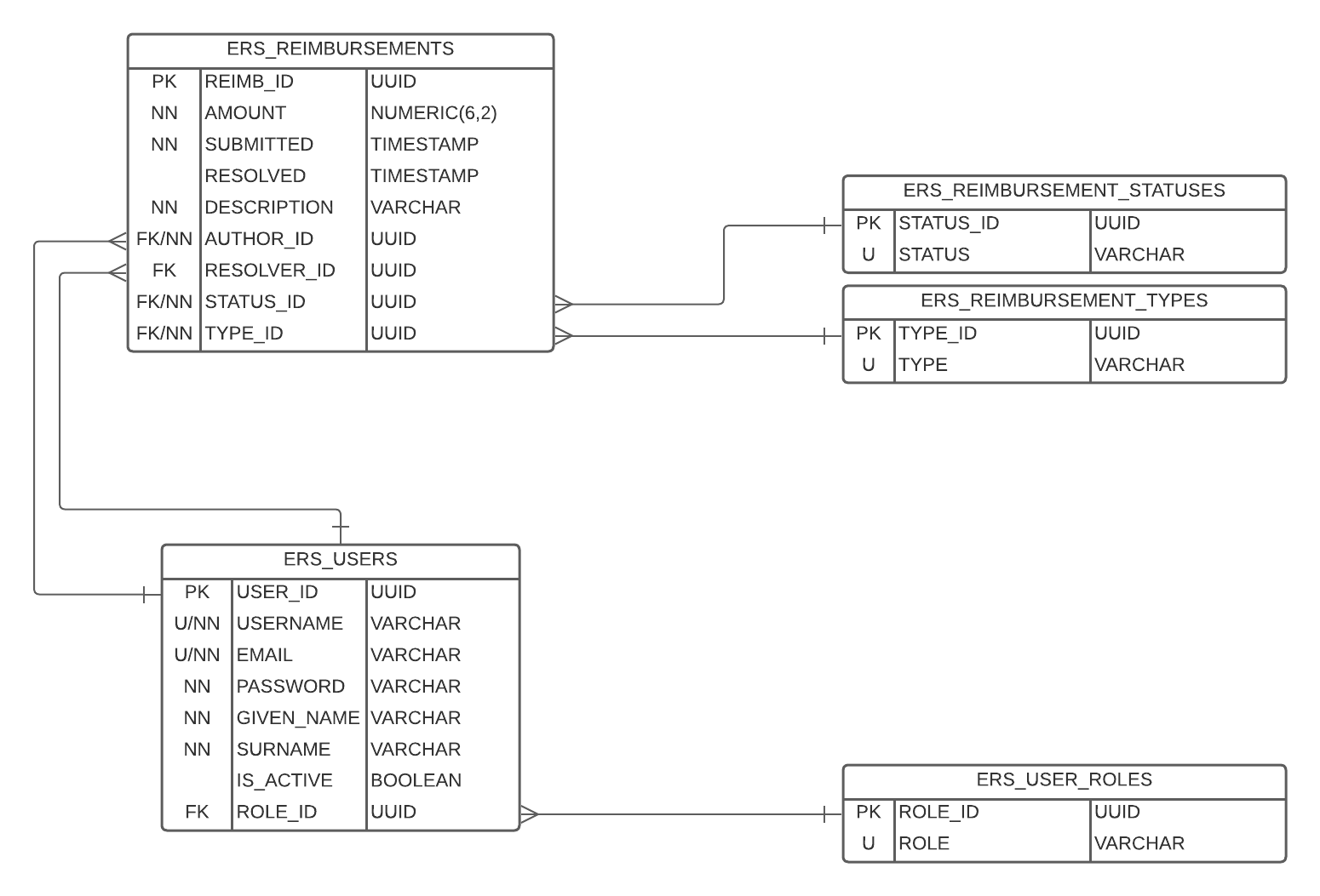
ERD – ENTITY RELATIONSHIP DIAGRAM

Slide 9
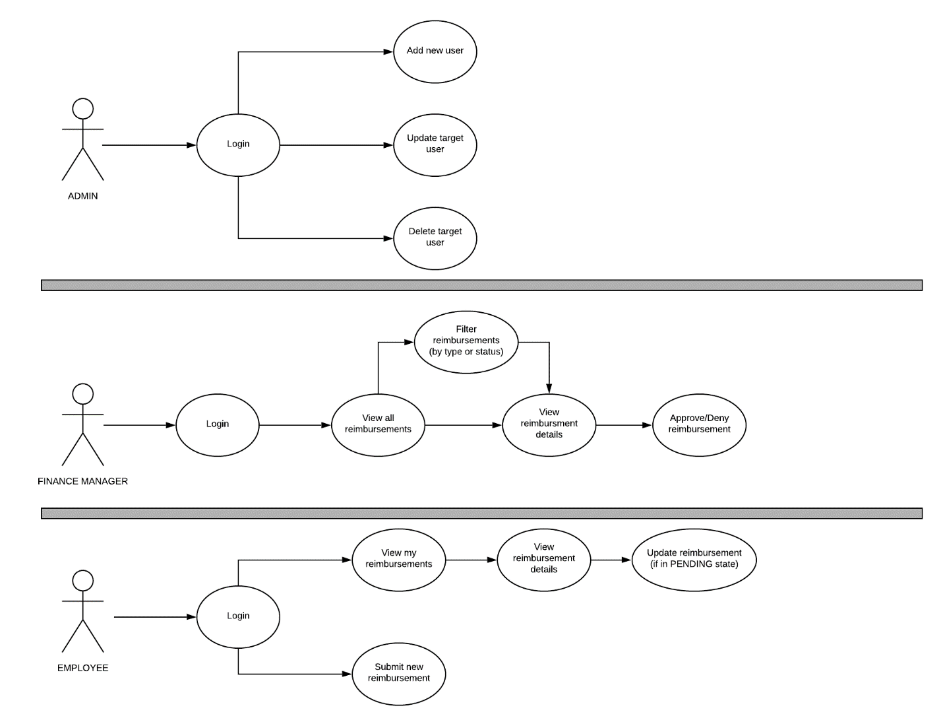
USE CASE DIAGRAM

Slide 10
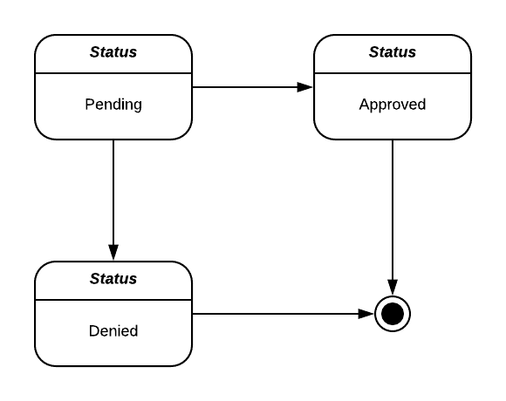
Reimbursement status state flow diagram

Slide 12
Design Stage / coding and implementation stage
Persistence Tier – PostGreSQL
Application Tier - Java 8, Spring 5 & Spring Boot, Apache Maven, Hibernate & Spring Data, Junit and Mockito
Client Tier – HTML, CSS, TypeScript, Angular
Deployment Platform Tools - Cloud Provider: Amazon Web Services (AWS), Database Deployment: AWS Relational Database Service (RDS)
Server Deployment: AWS Elastic Beanstalk (EB) + AWS Elastic Compute Cloud (EC2)
UI Deployment: AWS Simple Storage Service (S3)
Build Automation: AWS Code Build
Pipeline Management: AWS Code Pipeline

Slide 13
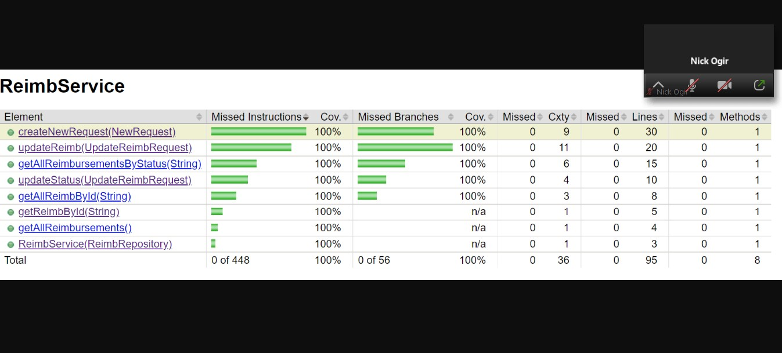
testing

Slide 14
deployment
DEPLOYMENT :
AUTOMATED USING PIPELINE

Slide 15
mainteince
Testing and logging was completed to ensure the API conform to:
REST ARCHITECTURE:
Uniform interface.
Client–server.
Stateless.
Cacheable.
Layered system.
Code on demand (optional)

Slide 16
Conclusion of OUR slide show
STARTING OUR LIVE PRESENTATION
THANK YOU FOR YOUR TIME
NICK/REGINA/MAX

